Slide 1
Energy-Efficient Neuromorphic Computing
MS Project: Mid-Term Presentation
Khritish Kumar Behera
Roll: 17125, Email: khritish17@iiserb.ac.in
Electrical Engineering and Computer Science [EECS] Dept.
Indian Institute of Science Education and Research [IISER] Bhopal
Advisor: Dr. Kuntal Roy, Email: kuntal@iiserb.ac.in

Slide 2
Content
Introduction to Artificial Neural Networks
Training and Testing Phase
Perceptron, Activation Function
Forward Propagation
Gradient Descent, Backpropagation
7x5 Character Recognition Model
Neural Network Using Spintronics
Magnetic Anisotropy
Potential Landscape of a Magnet
Magnetic Field applied in the Hard axis and Easy axis
Multiferroics
Design of Neural Network in Hardware
Experimental
Electromagnet
Magnetic Thermal annealing
Gaussmeter
Summary

Slide 3
Content
Introduction to Artificial Neural Networks
Training and Testing Phase
Perceptron, Activation Function
Forward Propagation
Gradient Descent, Backpropagation
7x5 Character Recognition Model
Neural Network Using Spintronics
Magnetic Anisotropy
Potential Landscape of a Magnet
Magnetic Field applied in the Hard axis and Easy axis
Multiferroics
Design of Neural Network in Hardware
Experimental
Electromagnet
Magnetic Thermal annealing
Gaussmeter
Summary

Slide 4
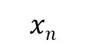
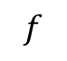
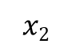
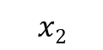
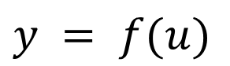
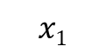
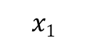
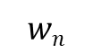

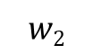
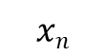
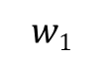
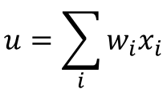
Energy-Efficient Neuromorphic Computing
$$x1$$
$$w1$$
$$u=\sum_{i}{w_{i}x_{i}}$$
$$y = f(u)$$
Majority of the Neuromorphic Computing are done on transistor based devices
$$x2$$
$$w2$$
$$Σ$$
.
.
.
$$wn$$
$$f$$
Spintronics based devices has inherent advantage over transistor:
Weight, Sum and Threshold function
Non-volatile in nature
$$xn$$
Y
Piezoelectric
$$x1$$
$$x2$$
$$xn$$
.
.
In terms of Energy dissipation, Transistor have ohmic loss, while spintronics devices does not have ohmic loss
ReadMTJ
Insulator
Magnetostrictive
Write
Non-Boolean Computing
Neuron

Slide 5
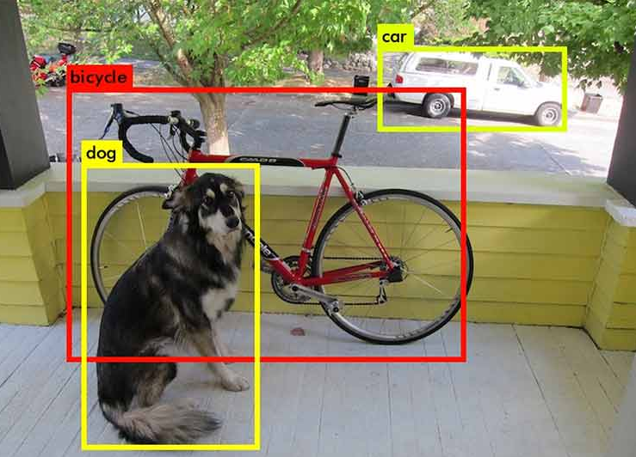

Artificial Neural Network: Motivation
Why Neural Network ?
Rise of Self Driving Car (Tesla)
Object Detection and Object Identification
Face Recognition in Airports
Face detection
Face Recognition
Notes:
Talk on success of ANN

Slide 6
Artificial Neural Network: Training & Testing Phase
Neural Network is a two-phase process
Training Phase
Testing Phase
Training Phase:
The model learns the underlying feature and mapping function of the given input-output data
Testing Phase:
Once the modeled is trained, new input data are feed into the model which were never used in the training phase
Training Data:
( X , T )
X: Input to the model
T: Expected value for input X
Testing is also used for checking whether the model is generalizing the data or its more biased towards the trained data
Input data is feed into the model
The model gives some output, form which the error is calculated
Based on the error, the tunning parameter of the model is changed
ERROR: T - O
X
O

Slide 7
Artificial Neural Network: Example
4x4 Character Recognition Model:
Each pixel value (1 or 0) is given to the model as input
The model trains on the training data
Later when test data is given, it gives an accurate result
A
.
.
.
.
.
.

Slide 8
Artificial Neural Network: Perceptron
X1
W1
b
Perceptron is the simplest and most basic form of a neural network
X2
W2
∑
σ
Y
X3
W3
A Simple Perceptron can have more than one input, but the output needs to be just one
Each input edge has a weight associated with it, which can be negative / positive / zero
Each node has a ‘bias’ term associated with it
The Neuron Process through two sequential processes: Summation and Activation

Slide 9
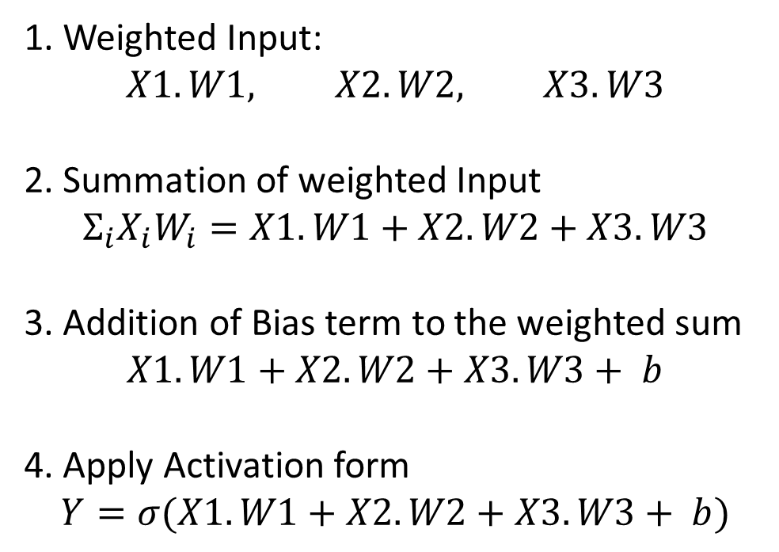
Artificial Neural Network: Perceptron
X1
W1
b
X2
W2
∑
σ
Y
1. Weighted Input:
$$X1.W1, X2.W2, X3.W3$$
2. Summation of weighted Input
$$Σ_{i}X_{i}W_{i}=X1.W1+X2.W2+X3.W3$$
3. Addition of Bias term to the weighted sum
$X1.W1+X2.W2+X3.W3+ b$
4. Apply Activation form
$$Y=σ(X1.W1+X2.W2+X3.W3+ b)$$
X3
W3

Slide 10
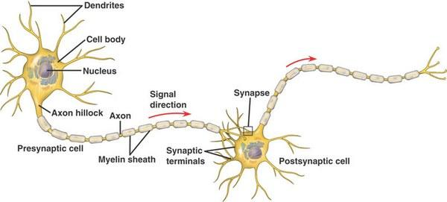
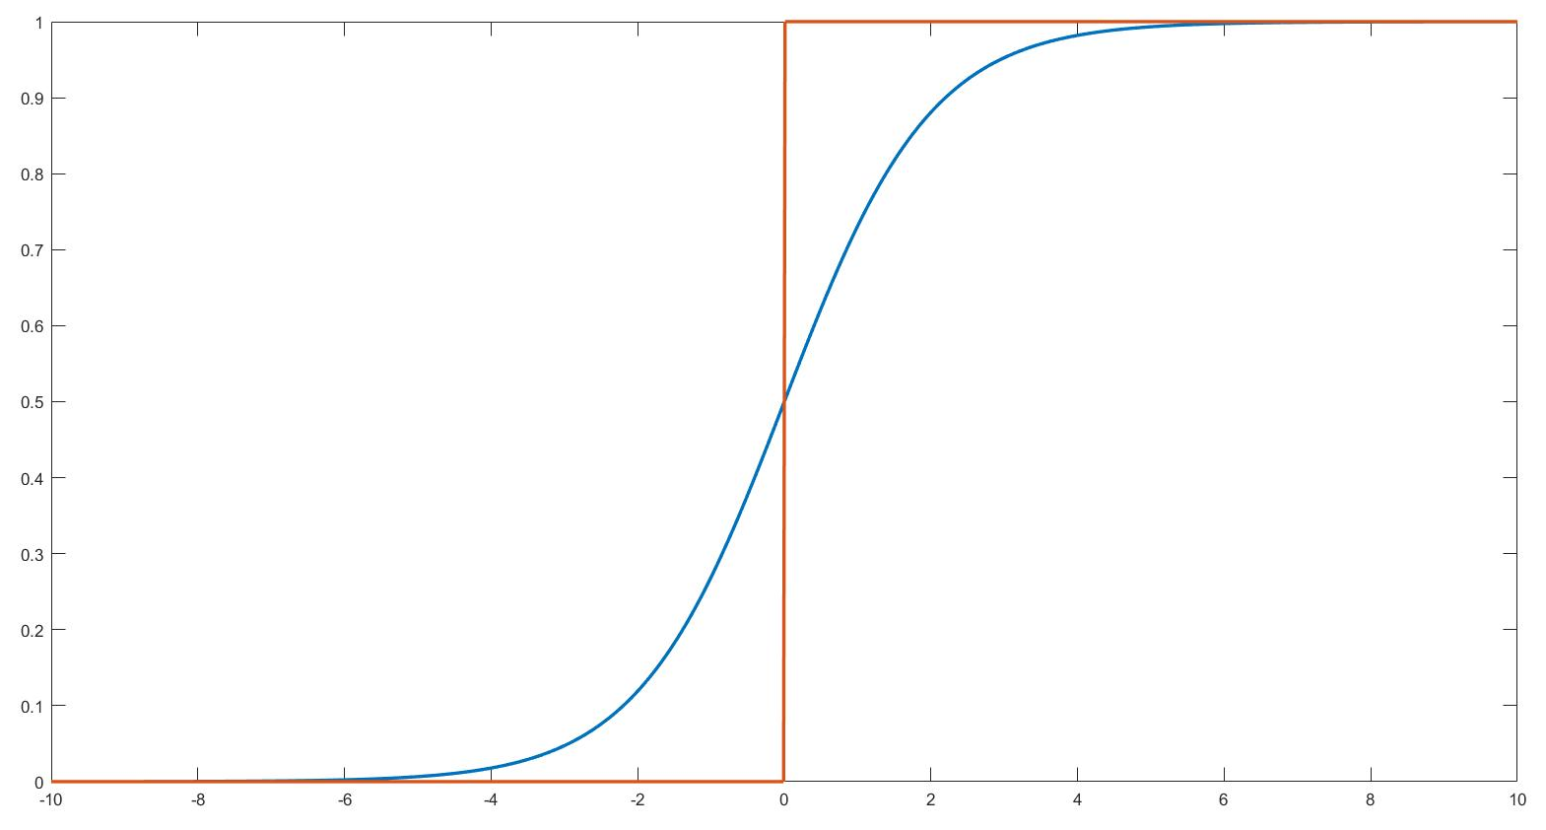
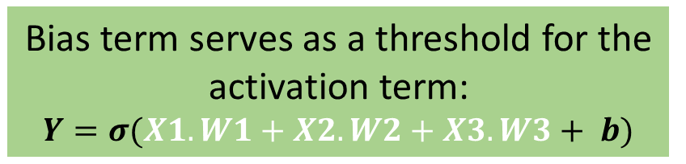
Artificial Neural Network: Activation Function
Activation Function is a non-linear mathematical function
Bias term serves as a threshold for the activation term:
$$Y=σ(X1.W1+X2.W2+X3.W3+ b)$$
Activation Function is inspired from biological neuron:
Neurons would not fire, and pass the input signal to the next neuron until and unless certain threshold is reached
Bias

Slide 11
Artificial Neural Network: Activation Function
Non-Linearity of Activation Function is the super-power of Artificial Neural Network
Output
Output
Input
Input
The Yellow circle and the red square are linearly classifiable
The Yellow circle and the red square are not linearly classifiable

Slide 12
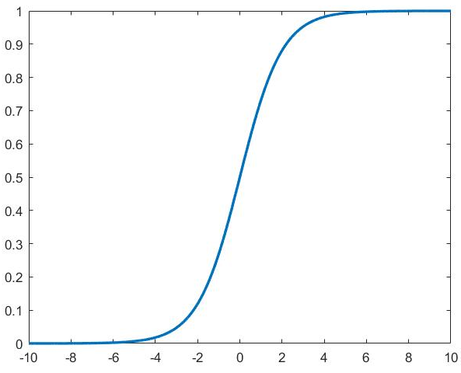
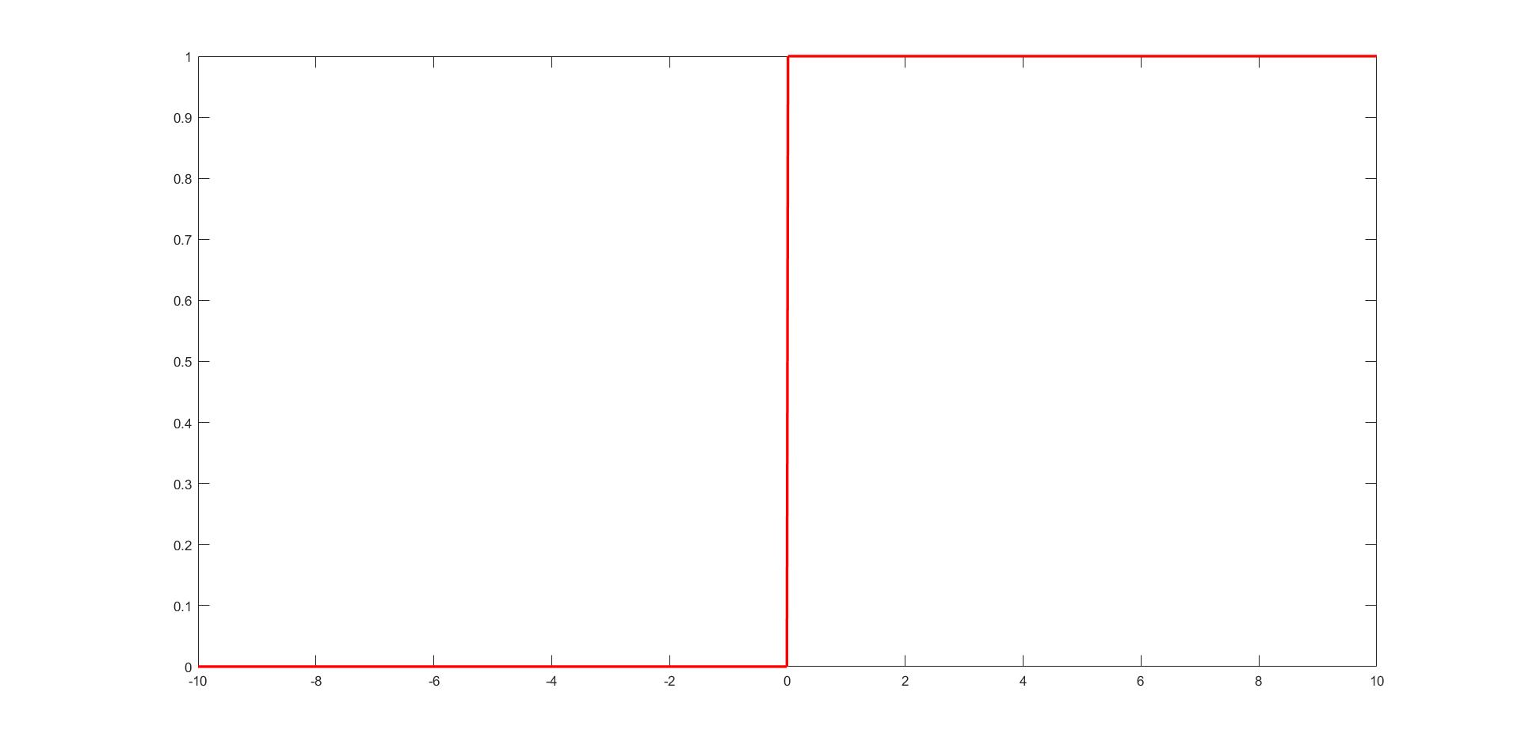
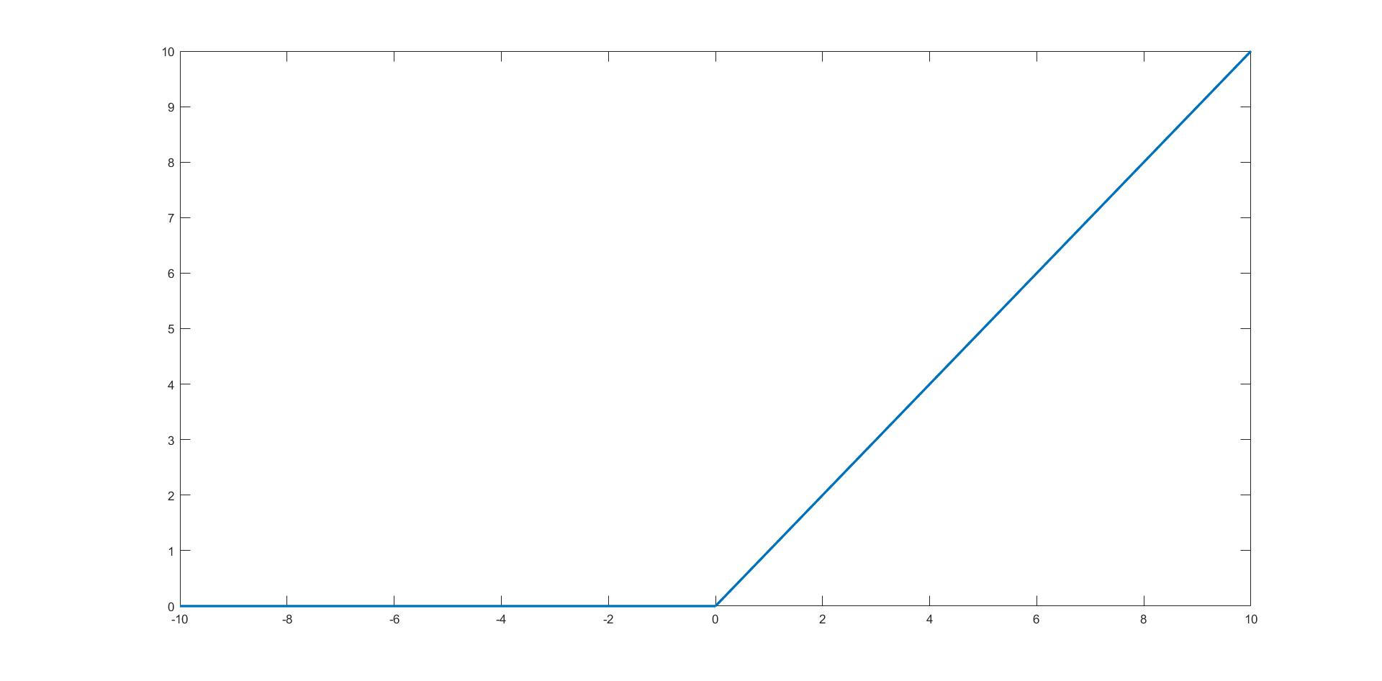
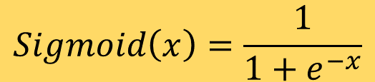
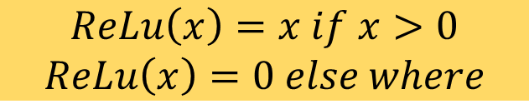
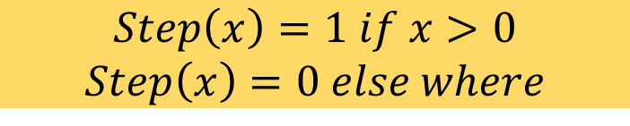
Artificial Neural Network: Activation Function
$$Step\left(x\right)=1 if x>0$$
$$Step\left(x\right)=0 else where$$
$$Sigmoid\left(x\right)=\frac{1}{1+e^{−x}}$$
Rectilinear Unit Function (ReLu)
$$ReLu\left(x\right)=x if x>0$$
$$ReLu\left(x\right)=0 else where$$

Slide 13
Artificial Neural Network: Simple ANN
An Artificial Neural Network is a system of connected artificial neurons
Output of each neuron of one layer is connected to the all the other neurons in the next layer
There are no self loops, no feedback loops
More than one edge emerging out of a neuron, does not mean that there are multiple output of the neuron

Slide 14
Artificial Neural Network: Simple ANN
Input Layer:
Simply transfer the input to next layer without altering
No. of neuron based on the problem
Hidden Layer:
At least one hidden layer
At least one hidden neuron per hidden layer
Output Layer:
Final output to the user
No. of neuron based on the problem

Slide 15
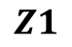
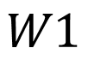
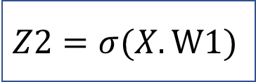
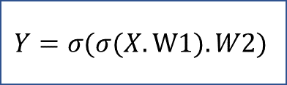
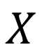
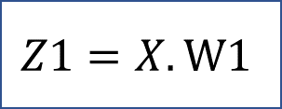
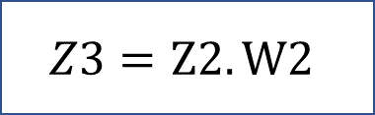
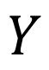
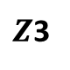
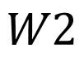
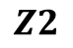
Artificial Neural Network: Forward Propagation
$$W1$$
$$Z1$$
$$Z2$$
$$W2$$
$Z$3
$$X$$
1
2
3
$$Y$$
$$Z1=X.W1$$
$$Z2=σ(X.W1)$$
$$Z3=Z2.W2$$
$$Y=σ(σ(X.W1).W2)$$
Input traversal from Input layer to Output layer through hidden layer

Slide 16
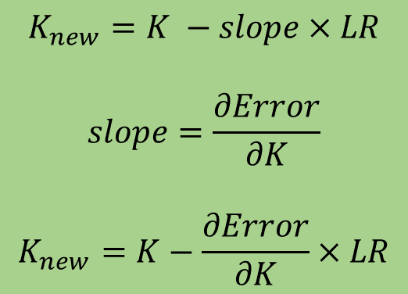
Artificial Neural Network: Gradient Descent
Error
Initial Point
$$K_{new}=K −slope×LR$$
$$slope=\frac{∂Error}{∂K}$$
$$K_{new}=K−\frac{∂Error}{∂K}×LR$$
K (Optimizing Parameter)
LR : Learning Rate

Slide 17
Artificial Neural Network: Gradient Descent
Error
K (Optimizing Parameter)
K is chosen randomly to increase the probability to not get stuck in a local minima
Getting stuck in local minima is un-avoidable but can be minimized

Slide 18
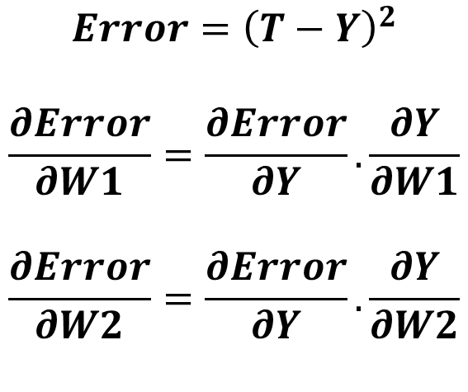
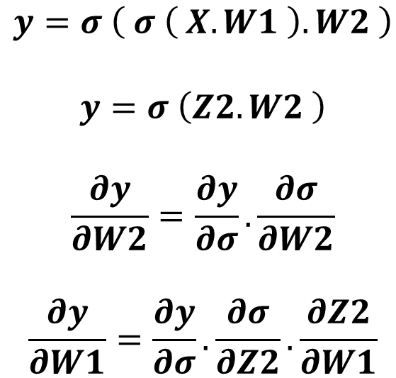
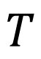
Artificial Neural Network: Backpropagation
$$T$$
Target
$$W1$$
$$Z2$$
$$W2$$
$$X$$
1
2
3
$$Y$$
$$y=σ \left( σ \left( X.W1 \right).W2 \right)$$
$$y=σ \left(Z2.W2 \right)$$
$$\frac{∂y}{∂W2}=\frac{∂y}{∂σ}.\frac{∂σ}{∂W2}$$
$$\frac{∂y}{∂W1}=\frac{∂y}{∂σ}.\frac{∂σ}{∂Z2}.\frac{∂Z2}{∂W1}$$
$$Error={\left(T−Y\right)}^{2}$$
$$\frac{∂Error}{∂W1}=\frac{∂Error}{∂Y}.\frac{∂Y}{∂W1}$$
$$\frac{∂Error}{∂W2}=\frac{∂Error}{∂Y}.\frac{∂Y}{∂W2}$$

Slide 19
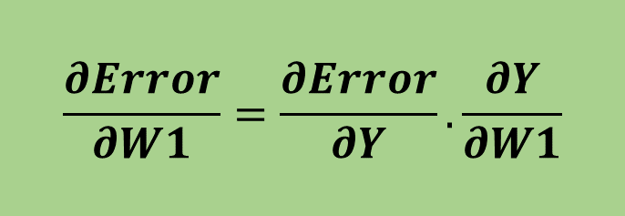

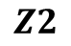

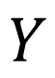
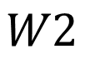
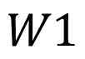
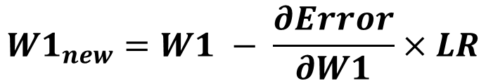
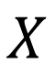
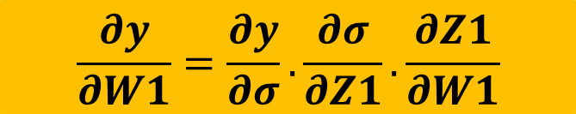
Artificial Neural Network: Backpropagation
$$W1$$
$$Z2$$
$$W2$$
$$X$$
1
2
3
$$Y$$
$$W1$$
$$Z2$$
$$W2$$
$$Y$$
$$X$$
$$σ$$
$$σ$$
Error
$$\frac{∂Error}{∂W1}=\frac{∂Error}{∂Y}.\frac{∂Y}{∂W1}$$
$$\frac{∂y}{∂W1}=\frac{∂y}{∂σ}.\frac{∂σ}{∂Z1}.\frac{∂Z1}{∂W1}$$
$$W1_{new}=W1 − \frac{∂Error}{∂W1}×LR$$

Slide 20
Artificial Neural Network: Character Recognition
We wish to create an ANN which can recognize alphabets from a noisy 7x5 pixel binary pattern
A
A

Slide 21
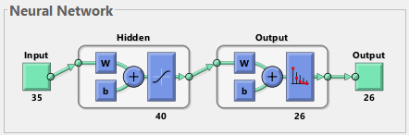
Artificial Neural Network: Neural Architecture
Input:
35-Bit word of the test character
Output:
26-Bit word suggesting the character
A: 1,0,0,0,0,0,0,0,…..0,0,0,0
B: 0,1,0,0,0,0,0,0,……0,0,0,0
C: 0,0,1,0,0,0,0,0,……0,0,0,0
Similarly others

Slide 22
Artificial Neural Network: Setting Neural Architecture
No. of Hidden Layer ?
No. of Hidden Neuron per Hidden Layer ?
Testing Error
Error
Training Error
Optimal number of neuron for a hidden layer:
Plot the testing and training error iterating from 1 to Max hidden neuron
Consider those neuron where testing error has minima
Error Gap
Neurons no.
Optimal number of neurons in hidden layer
Optimal number of hidden layer:
Calculate the no. of hidden neuron for first layer
Using this no. calculate for second layer, continue until the error gap starts increasing
Error Gap:
(Testing Error – Training Error)
at the optimal hidden neuron

Slide 23
Artificial Neural Network: Noise Tolerance
520 data of these 26 character were taken and added some noise degree ranging from 4-Bit to 8-Bit flip
4-Bit Flip
Correct Recognition: 0.913
Wrong Recognition: 0.087
7-Bit Flip
Correct Recognition: 0.5923
Wrong Recognition: 0.4077
5-Bit Flip
Correct Recognition: 0.7942
Wrong Recognition: 0.2058
8-Bit Flip
Correct Recognition: 0.4635
Wrong Recognition: 0.5365
6-Bit Flip
Correct Recognition: 0.7077
Wrong Recognition: 0.2923
Test Data with mix noises varying from 4-bit to 8-bit Results:
Correct Prob. = 0.7203
Wrong Prob. = 0.2797
Noise tolerance is up to 6-Bit flip

Slide 24



Artificial Neural Network: Noise Tolerance
ORIGINAL
4 BIT FLIP
5 BIT FLIP
$$✓$$
$$✓$$
A
A
8 BIT FLIP
7 BIT FLIP
6 BIT FLIP
✗
✗
$$✓$$
G
Q
A

Slide 25
Content
Introduction to Artificial Neural Network
Training and Testing Phase
Perceptron, Activation Function
Forward Propagation
Gradient Descent, Backpropagation
7x5 Character Recognition Model
Neural Network Using Spintronics
Magnetic Anisotropy
Potential Landscape of a Magnet
Magnetic Field applied in the Hard axis and Easy axis
Multiferroics
Design of Neural Network in Hardware
Experimental
Electromagnet
Magnetic Thermal annealing
Gaussmeter
Summary

Slide 26
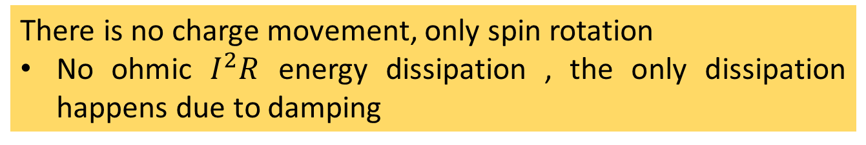
Spintronics: Spin-Electronics
Spin
Spin
Charge
Spin Up (↑) / Down (↓)
0 / 1
Electron
Spintronics device are non-volatile and endurable
Which gives an advantage over transistor, since transistor requires extra circuitry to have the non-volatile nature
Along with charge, electron have a spin
There is no charge movement, only spin rotation
No ohmic $I^{2}R$ energy dissipation , the only dissipation happens due to damping

Slide 27


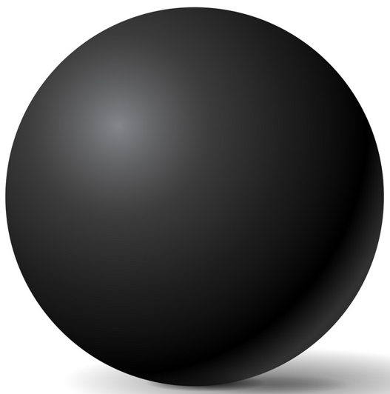
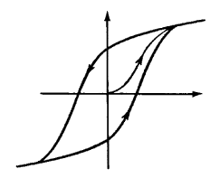










Magnetic Anisotropy
30-80 KT at 300 K
x
In-plane
Shape anisotropy
Magnetization
$$E barrier$$
$$θ$$
$$ϕ$$
z
CoFeB
y
$$φ=±90^{o}$$
$$H_{k}=\left(N_{d_yy}−N_{d_zz}\right)M_{s}$$
$$θ={180}^{o}$$
$$θ=0^{o}$$
$$E_{barrier}=\frac{1}{2}Ωμ_{0}M_{s}H_{k}\sin^{2}{θ}$$
M
Sphere
$$Ω:Volume$$
H
H_{k}
Ellipsoid

Slide 28









Potential Landscape of Magnet
$$E_{shape}\left(θ,φ\right)=\frac{1}{2}μ_{0}M_{s}\left[H_{k}+ H_{d}\cos^{2}{φ}\right]Ω\sin^{2}θ$$
$$H_{k}=\left(N_{d_yy}−N_{d_zz}\right)M_{s}$$
$$H_{d}=\left(N_{d_xx}−N_{d_yy}\right)M_{s}$$
$$M_{s}=8×{10}^{5}\frac{A}{m}$$
$$\left(a,b,t\right)=\left(100nm, 90nm, 6nm\right)$$
$$N_{d}=(0.8529, 0.0788, 0.0683)$$
$$Energy$$
$$θ ( in degree)$$
$$φ ( in degree)$$
Notes:
Increase the axis font, plot phi 85-95

Slide 29







Magnetic Field applied along in-plane hard axis
$$E=\frac{1}{2}μ_{0}M_{s}H_{k}\sin^{2}{θ−μ_{0}M_{s}H_{y}\sin{θ }}$$
$$\frac{dE}{dθ}=0$$
$$\sin{θmin=\frac{H_{y}}{H_{k}} }$$
$$θmin=\sin^{−1}\left(\frac{H_{y}}{H_{k}}\right)$$
Magnetic Field applied along Y-axis
Notes:
Plot it, animation with magnetization direction

Slide 30



Magnetic Field applied along in-plane Easy axis
$$E=\frac{1}{2}μ_{0}M_{s}H_{k}\sin^{2}{θ−μ_{0}M_{s}H_{z}\cos{θ }}$$
$$θmin=\sin^{−1}\left(\frac{H_{y}}{H_{k}}\right)$$
Magnetic Field applied along Z-axis
Notes:
Plot it, animation with magnetization direction

Slide 31
Magnetic Field applied along in-plane hard axis
$$E=\frac{1}{2}μ_{0}M_{s}H_{k}\sin^{2}{θ−μ_{0}M_{s}H_{y}\sin{θ }}$$
$$\frac{dE}{dθ}=0$$
$$\sin{θmin=\frac{H_{y}}{H_{k}} }$$
$$θmin=\sin^{−1}\left(\frac{H_{y}}{H_{k}}\right)$$
Magnetic Field applied along Y-axis
Notes:
Plot it, animation with magnetization direction

Slide 32
Magnetic Field applied along in-plane Easy axis
$$E=\frac{1}{2}μ_{0}M_{s}H_{k}\sin^{2}{θ−μ_{0}M_{s}H_{z}\cos{θ }}$$
$$θmin=\sin^{−1}\left(\frac{H_{y}}{H_{k}}\right)$$
Magnetic Field applied along Z-axis
Notes:
Plot it, animation with magnetization direction

Slide 33





Multiferroics and Multiferroic Composites
Multiferroic
Magnetostrictive
Piezoelectric
Strain
E
E
Piezoelectricity
Magnetoelectricity (intrinsic)
Piezoelectricity
Magnetoelectricity (intrinsic)
P
P
$$ε$$
M
$$ε$$
M
$$σ$$
H
$$σ$$
H
Magnetostriction
Magnetostriction
$$\boxed{α_{ME}=μ_{0}\frac{∂M}{∂E}}$$
$$\boxed{α_{ME}=μ_{0}\frac{∂M}{∂σ}\frac{∂σ}{∂E}}$$
Notes:
Change it to multiferroic composites

Slide 34









Magnetostriction
Magnetostrictive Material : Certain ferromagnetic specimen changes its shape (strain: $\frac{∂l}{l}$) during the process of magnetization
Magnetostrictive Anisotropy ↔ Stress Anisotropy
Cobalt:
$$\frac{3}{2}λ=30×{10}^{−6}$$
FeGa:
$$\frac{3}{2}λ=150×{10}^{−6}$$
$$\frac{3}{2}λ σ Ω \cos^{2}θ$$
$λ:$ Magnetostriction Co-efficient
$$σ:Stress$$
$$Ω:Volume$$
$$d=3000\frac{pm}{V}$$
$$Y=250×{10}^{9} Pa$$
$$t=100 nm$$
Stress Anisotropy (for FeGa):
$\frac{3}{2}λ σ Ω \cos^{2}θ$
$=2.4×{10}^{−18} J$ (max.)
$$σ=Y.\left(strain\right)$$
$$=Yd\frac{V}{t}$$
Notes:
40KT =1eV=1.610-19J

Slide 35


Multiferroic composites Voltage vs stress anisotropy
V_{in}
t_{mag}
Magnetostrictive
$$ε_{piezo}=d_{piezo}×\left(\frac{V_{in}}{t_{piezo}}\right)$$
$$ε_{mag}≃ε_{piezo}$$
$$σ=Y ε_{mag}$$
Piezoelectric
t_{piezo}
x (1)
y (2)
z (3)
Choose piezoelectric layer with high de-coefficient
strain transfer
Y: Young’s modulus
magnetostrictive layer
with high $λY$

Slide 36
Multiferroic composites Voltage vs stress anisotropy
V_{in}
t_{mag}
Magnetostrictive
Piezoelectric
t_{piezo}
x (1)
strain transfer
y (2)
z (3)
Y: Young’s modulus
Anisotropic strain along the two directions of lateral area (PMN-PT, PZN-PT)
: Poisson’s ratio
Choose piezoelectric layer with high d₃₁- d₃₂ (e.g., PMN-PT, PZN-PT)
magnetostrictive layer
with high (3/2)_{s}Y/(1+)
(e.g., Terfenol-D, Galfenol)
t_{piezo} should be high enough for assumption

Slide 37

Design of Neural Network
Electric Potential
Stress in Piezoelectric
Stress in Magnetostrictive
Changes the magnetization direction in the lower plate of TMR
Changes magnetization of Magnetostrictive
Creates different resistance
ReadMTJ
Insulator
$$x1$$
Magnetostrictive
Write
$$w1$$
$$y = f(u)$$
$$x2$$
$$w2$$
$$Σ$$
Piezoelectric
.
.
.
$$wn$$
x₁
$$f$$
x₂
$$xn$$
Neuron
x_{n}
.
.

Slide 38
Content
Introduction to Artificial Neural Network
Training and Testing Phase
Perceptron, Activation Function
Forward Propagation
Gradient Descent, Backpropagation
7x5 Character Recognition Model
Neural Network Using Spintronics
Magnetic Anisotropy
Potential Landscape of a Magnet
Magnetic Field applied in the Hard axis and Easy axis
Multiferroics
Design of Neural Network in Hardware
Experimental
Electromagnet
Magnetic Thermal annealing
Gaussmeter
Summary

Slide 39
Experimental
Electromagnet for magnetic alignment
Magnetic Thermal Annealing for better magnetic characterization
Gaussmeter for measuring the magnetic field
Sputtering for deposition of different materials, e.g., piezoelectric, magnets
Electron Beam Lithography (EBL) for patterning single-domain nanomagnets
Magnetic Force Microscopy (MFM) for visualizing single-domain nanomagnets
Ferromagnetic Resonance (FMR) for characterizing the magnetic damping parameter
Vibrating Sample Magnetometer (VSM) for magnetic hysteresis

Slide 40


Electromagnet
Chiller
Constant Current
Power Supply
Magnetic Coil
Gauss Probe
Magnetic Coil: When electric current is passed through the magnetic coils it generates a constant magnetic field
Gauss Probe: It is used to measure the magnetic field generated between the poles
Constant Current Power Supply: Provides a constant current to the magnetic coil which in turn a constant magnetic field
Chiller: Is required to reduces the temperature of the magnetic coil

Slide 41




Magnetic Thermal Annealing
Heater
Enhances the magnetic property of magnetic materials
Reorients the spin direction in the direction of the magnetic field
Heating of the sample is done in vacuum and the material MTA is made up of is not affected by the magnetic field
Vacuum Pump

Slide 42


Gaussmeter
Gauss Probe
Gaussmeter is a static electronic magnetic field measurement device
Probes used in Gaussmeter:
Axial Probe: Measures the magnetic field parallel to the probe
Transversal Probe: Measures the magnetic field perpendicular to the probe
It measures by the Hall effect, which is the conversion of magnetic field into Hall Voltage
Electrons in magnetic field tries to move in perpendicular direction of applied magnetic field (Lorentz force)

Slide 43










Gaussmeter
H↑
$$θ→$$
R = 2.5cm : $0^{0}<θ<{360}^{0}$
H↑
H↑
$$θ→$$
$$θ→$$
R = 3.6cm : $0^{0}<θ<{360}^{0}$
R = 5cm : $0^{0}<θ<{360}^{0}$

Slide 44










Gaussmeter
H↑
$φ$→
R = 2.5cm : $0^{0}<φ<{360}^{0}$
H↑
H↑
$φ$→
$φ$→
R = 3.6cm : $0^{0}<φ<{360}^{0}$
R = 5cm : $0^{0}<φ<{360}^{0}$

Slide 45
Summary
Understanding of the working principle of ANN
Implemented a 7x5 Character Recognition Model
Learned about magnetic anisotropy, Multiferroics and Multiferroic Composites
Implemented the above learned concepts in sketching out the idea for making a hardware based artificial neuron
Worked on EM, ETA and Gaussmeter
Future Works
Will start working on sputtering for deposition, EBL for pattering
Fabrication of the device
Notes:
Write in the perspective of what I have done until now and what I will do in the project

